Slide 1

Econometrics Data Validation
Assessment Findings
By Shaikh Rezwan

Slide 2
Pre-Analysis Findings
THE DATASET
Raw Data:
Date | Campaign | Cost | Impressions
04/02/2015 | Branded Broad | 8.49 | 4315
04/02/2015 | Competitors Broad | 23.25 | 5407
04/02/2015 | X_B | UK | Exact | 3.6 | 2203
04/02/2015 | X_LT | UK | Competitors | Exact | 5.3 | 2328
05/02/2015 | Competitors Broad | 4.56 | 3804
Here are some of our findings from the dataset, of which a few rows are shown on the left:
Our data is comprised of a time-series tracking of ‘Costs’ and ‘Impressions’ for Campaigns during a period of four years.
The data contained some missing values for the ‘Impressions’ column and an unnamed column, which indicates inconsistent data recording for some days.
For aggregating and analyzing the data by week, we grouped the total cost and impressions values for each week (e.g. from Week 1 to Week 52).
Furthermore, we looked at weekly time-series charts to track changes in the cost and impressions for each campaign over the weeks. These will be shown over consequent slides.
We also performed top-line level analysis and drilling down into granular level along with slicing the dataset to find aggregating metrics for the dataset.
Campaign Lookup Data:
Campaign | Channel | Brand/Generic | Type
[UK] - GDN | Display | Generic | Prospecting
[UK] - Video | Display | Generic | Prospecting
[UK] - Video Remarketing | Display | Generic | Remarketing
GDN: UK - Hybrid | Display | Generic | Prospecting
LT: UK Dis Comp_Context | Display | Generic | Prospecting

Slide 3
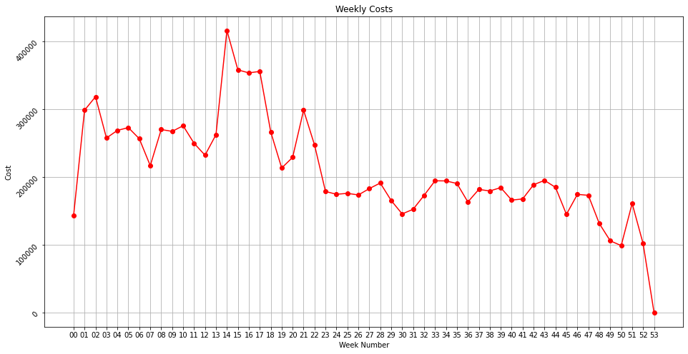
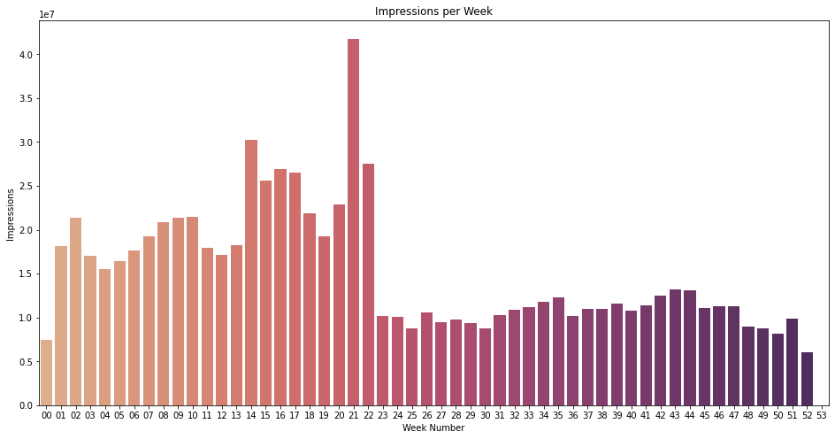
Weekly Time-Series Charts
Here are some insights the charts illustrate:
Both the costs value and the impressions are highest during the weeks leading from week 12 till week 22 approximately.
The maximum cost is incurred around week 14 while the maximum impressions occurred around week 21.
The total metrics devaluate over time towards the end of the year.
P.S.- The cost and impressions values are the grouped sum for each week.

Slide 4

Here are some relevant metrics for the entire dataset at a top-line level
$11.3M | 805M | $149.5 | 10,624
Total Cost over the four Years | Total impressions over four years | Average cost for each week | Average impressions per week
Top-Line Level Metrics

Slide 5
Additional Insights
There is a notable difference in cost and impressions between the Brand and Generic categories.
The Brand category has a much lower cost and lower number of impressions compared to the Generic category.
This insight suggests that the marketing efforts for the Brand category may be more targeted and focused, resulting in a higher cost efficiency but potentially a less engaged audience.
Brand/Generic | Cost | Impressions
Brand | $3354481.59 | 28869263
Generic | $8058423.2 | 778304068
Table of the data sliced for Brand/Generic category.
Type | Cost | Impressions
Prospecting | $9776733.57 | 618369161
Remarketing | $1636171.22 | 188804170
Table of the data sliced for Type of marketing strategy.

Slide 6

To Conclude
For both categories Brand/Generic and Prospecting/Remarketing
The marketing campaign has been successful in generating a substantial number of impressions across both the Brand and Generic categories.
The same is also true for Prospecting customers, for whom more cost is incurred and more impressions gained compared to previous customers.
However, there is a significant difference in cost and impressions between the two categories, indicating the need for further evaluation of the marketing strategies employed.

Slide 7



Recommendations to Optimize Marketing Efforts
Conduct a deeper analysis
of the Brand category to understand the factors contributing to its lower cost and impressions.
Identify
successful branding elements and marketing strategies that can be leveraged to enhance the performance of the Generic category.
Explore
the possibility of reallocating resources from the Generic category to the Brand category, considering its lower cost and potential for higher engagement.
Evaluate
the effectiveness of the Prospecting and Remarketing types of campaigns.
Analyze
their cost and impressions to identify areas of improvement and prioritize strategies accordingly.
Continuously
monitor and analyze the campaign performance, regularly reviewing the cost and impressions metrics to make data-driven decisions and optimize marketing efforts.

Slide 8




THANK YOU!
The whole project along with the Python code and relevant charts can be found in the GitHub repo:
https://github.com/Rezwan66/exploration-of-econometrics-dataset

